Slide 1
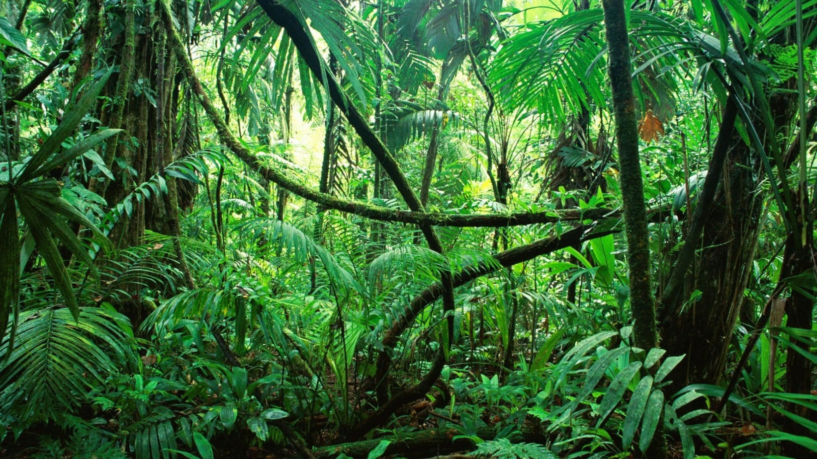
MODULE 5:
Reporting Biodiversity outcomes

Slide 2
Key Topics
Understanding biodiversity
Indigenous knowledge on biodiversity
What is biodiversity reporting and why it matters
Reporting biodiversity
Biodiversity Indicators
Community biodiversity monitoring tools
Conclusion

Slide 3

Understanding biodiversity
Biodiversity encompasses the comprehensive variety of life on Earth, including the intricate natural systems that sustain it. It comprises the diversity of flora, fauna, and microorganisms, the complex ecosystems they inhabit, and the genetic variation within individual species. This biological complexity is fundamental to ecological resilience and the continued support of life.

Slide 4
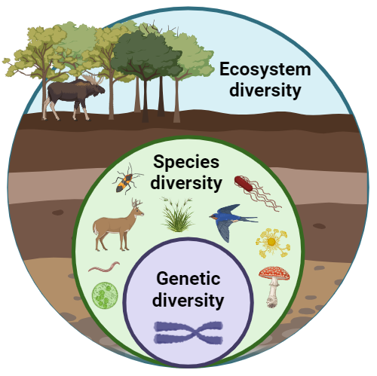
Key components of Biodiversity
The range of different habitats, ecosystems, and ecological processes such as forests, grasslands, wetlands, and marine systems
The variety and abundance of different species within a given area, contributing to ecosystem balance and stability.
Variation within a species that enables adaptation to environmental changes and strengthens resilience to diseases and climate stress.

Slide 5
Why Biodiversity Matters
Biodiversity sustains human life, the global economy and environment stability making it the foundation of the ecosystem services. Biodiversity is essential to the health and integrity of forest, grassland, and marine ecosystems. It provides critical adaptation functions, including buffering against climate extremes, regulating hydrological cycles, protecting soils, moderating urban temperatures, reducing food insecurity, and supporting economic diversification—particularly during periods when climate change impacts reduce agricultural productivity.

Slide 6
Why Biodiversity Matters
These functions are fundamental not only to climate resilience but to sustaining life on Earth. Biodiversity is however under threat due to climate change, pollution, habitat loss and degradation, invasive species, habitat loss and degradation. Protecting biodiversity requires:
Sustainable land and resource management
Community and indigenous-led conservation approaches
Strong policies and legal frameworks
Monitoring and reporting on biodiversity outcomes

Slide 7
Indigenous knowledge on biodiversity
International frameworks such as the Convention on Biological Diversity (CBD), IPBES, and the UN Declaration on the Rights of Indigenous Peoples (UNDRIP) continue to increasingly recognize indigenous knowledge. These frameworks emphasize the importance of respecting Indigenous rights, ensuring free, prior, and informed consent (FPIC), and promoting Indigenous-led conservation.
Indigenous people’s way of life support biodiversity in different ways that include;
Sustainable resource management: Practices such as rotational grazing, seasonal harvesting, and sacred site protection help maintain ecosystem balance.

Slide 8
Indigenous knowledge on biodiversity
Species conservation: Indigenous communities identify, protect, and sustainably use plant and animal species for food, medicine, and cultural purposes.
Ecosystem stewardship: Traditional fire management, water conservation, and soil protection practices enhance ecosystem resilience.
Agrobiodiversity: Indigenous seed systems and crop diversity improve food security and climate adaptation.

Slide 9
Indigenous knowledge on biodiversity
Place-based and context-specific: Knowledge is tailored to local ecosystems such as forests, rangelands, wetlands, and coastal areas.
Indigenous knowledge therefore is a cumulative body of knowledge, practices, and beliefs developed by Indigenous Peoples over generations through close interaction with their natural environments. This knowledge system is holistic, place-based, and deeply rooted in cultural values, spirituality, and lived experience.
Indigenous knowledge on biodiversity can be characterized by;
Intergenerational: Passed down orally through elders, cultural practices, stories, and rituals.
Holistic: Integrates ecological, social, cultural, and spiritual dimensions of biodiversity.
Adaptive: Continuously evolves in response to environmental change and climatic variability.

Slide 10
What is biodiversity reporting and why it matters
Biodiversity reporting is the systematic collection, analysis, and communication of information on the status, trends, and outcomes related to biodiversity. It documents how ecosystems, species, and genetic resources are being conserved, restored, or sustainably used, and how interventions affect biodiversity over time.
Biodiversity reporting may cover:
Changes in species populations and habitats
Conservation and restoration actions
Threats and risks to biodiversity
Community and indigenous stewardship practices
Impacts of projects, policies, or investments on biodiversity

Slide 11
Why Biodiversity Reporting Matters
Accountability and Transparency
Informed Decision-Making
Measuring Impact
Learning and Adaptation
Compliance with Policies and Frameworks
Recognition of Indigenous and Local Knowledge
Mobilizing Resources and Partnerships

Slide 12
Biodiversity indicators
Biodiversity indicators are measurable variables used to assess the condition, trends, and changes in biodiversity over time. They help track the effectiveness of conservation actions, inform decision-making, and support reporting to stakeholders, governments, and donors.

Slide 13
Indicator Category | What It Measures | Examples of Indicators
Species-Level Indicators | Status and trends of species populations | Species abundance and population trends; Species richness; Presence or absence of indicator or keystone species; Status of threatened or endangered species
Ecosystem / Habitat Indicators | Health, extent, and condition of ecosystems | Area of habitat conserved or restored; Habitat quality and fragmentation; Ecosystem integrity; Land-use and land-cover change
Genetic Diversity Indicators | Diversity within species | Number of traditional crop varieties or livestock breeds conserved; Genetic variation in key species; Indigenous seed system use
Threat and Pressure Indicators | Drivers of biodiversity loss | Deforestation rates; Habitat degradation; Presence of invasive species; Pollution levels; Climate-related stress indicators
Response / Management Indicators | Conservation and management actions | Area under protected or community-managed conservation; Adoption of sustainable practices; Policy enforcement; Community participation in conservation
Socio-Economic & Governance Indicators | Links between biodiversity, people, and institutions | Biodiversity-based livelihoods; Benefit-sharing mechanisms; Indigenous and community governance systems; Gender and social inclusion in biodiversity management

Slide 14
Community biodiversity monitoring tools
Tool | Description | What It Monitors / Use
Participatory Mapping | Community-led mapping of natural resources, habitats, and land use | Land-use change, habitat distribution, conservation and sacred areas
Community Species Registers | Locally maintained lists of plant and animal species | Species presence, diversity, seasonal patterns, population trends
Transect Walks | Guided walks along fixed routes to observe biodiversity indicators | Vegetation cover, wildlife signs, ecosystem health
Community Scorecards | Community assessment using agreed criteria and scoring | Biodiversity condition, conservation performance, accountability
Seasonal Calendars | Tracking seasonal cycles and ecological changes | Climate impacts, species behavior, harvesting periods
Indigenous Observation Logs | Documentation of Indigenous ecological observations and knowledge | Environmental changes, early warning signs, ecosystem trends
Photo and Video Monitoring | Visual documentation captured by community members | Environmental change over time, evidence for reporting and advocacy
Participatory Biodiversity Surveys | Simple surveys conducted by trained community members | Key species, habitat condition, conservation practices
Community Patrols / Ranger Logs | Routine patrol records and observations | Illegal activities, wildlife movement, habitat degradation
Mobile and Digital Tools (Community-Adapted) | Use of simple mobile data collection platforms | Data collection, storage, analysis, and biodiversity reporting

Slide 15
Conclusion
Biodiversity is fundamental to ecological health, human well-being, and sustainable development. Understanding and protecting it is essential for building resilient ecosystems, supporting livelihoods, and ensuring a sustainable future for present and future generations.
Biodiversity reporting therefore serves as a cornerstone for advancing conservation, sustainable development, and climate resilience. Through the generation and dissemination of evidence-based insights, it fosters greater accountability and optimizes management frameworks. Ultimately, this transparency ensures the long-term preservation of vital ecosystems and the livelihoods that depend upon them

Slide 16

THE END

