Slide 1

MODULE 4: Communication & Reporting

Slide 2
Reporting and why reporting matters
Reporting is the systematic documentation and sharing of information is termed as reporting. Reporting is usually done to show progress, results, challenges, and lessons learned in a project or organization.

Slide 3
Why reporting matters;
Accountability: Keeps stakeholders (donors, communities, management) informed and ensures transparency
Communication: Strengthens relationships with beneficiaries, partners, and funders by sharing outcomes.
Decision-making: Provides evidence to guide project adjustments and strategic decisions.
Learning: Helps identify successes, failures, and areas for improvement.
Tracking progress: Monitors achievement against objectives, milestones, and indicators.
Compliance: Meets legal, donor, and organizational requirements.

Slide 4
Types of reports
Reporting is the primary tool for transparency and decision-making. Reports are categorized by their purpose, target audience, and submission frequency. The common types include;
Type | Purpose | Audience | Frequency
Progress Report | Tracks ongoing project activities and outputs | Donors, management | Monthly/Quarterly
Financial Report | Details budget use, expenditures, and financial compliance | Donors, finance team | Monthly/Quarterly/Annual
Narrative/Story Report | Describes achievements, challenges, and lessons | Stakeholders, community, donors | Project milestones or end-line
Evaluation Report | Assesses effectiveness, impact, and relevance | Donors, management, policy makers | Mid-term or end-line
Annual Report | Summarizes yearly accomplishments, financials, and strategic updates | Public, donors, board | Annually
Ad-hoc Report | Specific events, incidents, or urgent updates | Management, partners | As needed

Slide 5
Reporting Structures
A well-defined reporting structure ensures clarity, efficiency, and accountability. Common elements include:;
Field Staff
Collect data, document activities
Project Coordinators
Verify, analyze, and consolidate data
MEAL/Program Manager
Review and submit reports
Executive/Board
Oversight and strategic decisions
Donor

Slide 6
Learning and Adaptation
Learning and Adaptation represent the transition from data collection to strategic action. This process, often referred to as Adaptive Management, ensures that projects remain resilient, responsive to community needs, and aligned with long-term goals
Evidence Integration: Synthesizing findings from quantitative monitoring, formal evaluations, and qualitative stakeholder feedback
Knowledge Stewardship: Documenting both successes and failures to build a "Community Knowledge Bank" that informs future generations and prevents the repetition of errors.
Agile Adjustments: Proactively modifying strategies, activity designs, or resource allocations in response to real-time data
Risk Mitigation: Identifying emerging challenges early and pivoting to protect the project's Cultural Integrity and Fiduciary Stability
ADAPTATION
LEARNING

Slide 7
Effective Communication in reporting
Good reporting communication is clear, simple, and focused on the audience. It uses organized formats, visuals, and plain language, avoids jargon, ensures accuracy through proper analysis, and presents information in a way that helps stakeholders understand and act on it quickly

Slide 8
Key principles for effective reporting
Principle | Description
Clarity and Simplicity | Use clear, straightforward language that is easy to understand, avoiding jargon and overly complex wording so key messages are immediately clear.
Conciseness | Present information briefly and directly, focusing on essential points while eliminating unnecessary detail to respect the reader’s time.
Audience Focus | Tailor content, tone, and level of detail to the needs and expectations of the intended audience, such as donors, managers, or community stakeholders.
Structure and Formatting | Organize information logically using headings, bullet points, tables, and charts, with adequate spacing to improve readability and comprehension.
Accuracy and Evidence | Ensure all information is correct, verified, and supported by reliable data and analysis, with appropriate references where required.
Completeness | Provide all necessary information to fully explain the situation or findings, while maintaining clarity and brevity.
Actionability | Highlight practical insights, clear conclusions, and specific recommendations or next steps that readers can easily act upon.

Slide 9
Methods of communication
Effective communication methods
Written Communication: Reports, newsletters, policy briefs, case studies
Verbal Communication: Meetings, presentations, community dialogues, staff briefings
Digital Communication: Emails, project dashboards, social media, WhatsApp group
Participatory Communication: Community forums, focus groups, storytelling sessions
Visual Communication: Infographics, charts, dashboards, videos, photos

Slide 10
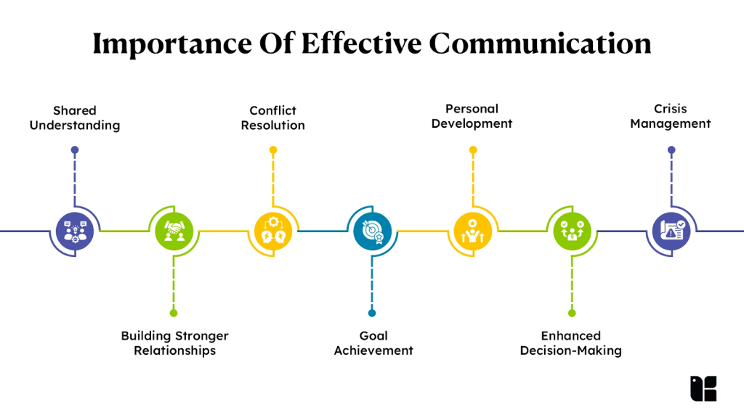
Importance of communication
Through effective communication, the following objectives are achieved;

Slide 11
conclusion
Reporting delivers accurate and timely information that supports accountability and informed decision-making. Learning and adaptation transform data into practical improvements that enhance project effectiveness.
While communication ensures that insights and results are shared clearly and effectively with stakeholders. Together, these interlinked pillars of effective project management strengthen transparency, improve program outcomes, and build trust with communities, donors, and partners

Slide 12
THE END

